Slide 1
M.KUMARASAMY COLLEGE OF ENGINEERING , KARUR.
Register Number :927623BEC052,927623BEC053
Name :ELAKKIYA K,ELAMATHI S
Date :28.05.2025

Slide 2
TITLE OF THE PROJECT
LIBARY MANAGEMENT SYSTEM

Slide 3
Abstract
The Library Management System is a software tool designed to automate and manage library operations such as book records, member registration, issue/return of books, and fine calculation.
It replaces manual methods with a digital system to improve efficiency and reduce errors.
Developed using [your technologies], the system provides a user-friendly interface for both librarians and users, ensuring faster access to information and better organization of library resources.

Slide 4
Literature Review
Year | Authors | Title of the Paper | Algorithm/ Methodologies/ Techniques | Findings
2018 | Patel | Library Management System using Barcode Technology | Barcode | the use of barcode technology in LMS for efficient tracking and management of library resources.
2023 | Singh | Design and Development of Web-Based Library Management System | Web-based, MySQL | the design and development of a web-based LMS for efficient management of library resources.

Slide 5
Problem(s) Identified
The current manual library management system is inefficient, time-consuming, and prone to errors. The lack of automation and digital tracking leads to significant challenges, including difficulty in managing large collections of books and resources, inefficient borrowing and returning processes, inaccurate tracking of book availability and inventory, limited accessibility and visibility of library resources, and difficulty in managing member information and borrowing history.

Slide 6
Proposed Solution
The proposed solution is to implement a comprehensive Library Management System (LMS) that automates and streamlines library operations, providing features such as book management, member management, borrowing and returning, inventory management, and reporting and analytics, ultimately improving efficiency, productivity, and user experience while enabling accurate and real-time tracking of library resources.

Slide 7
Objectives
Automate Library Operations: Streamline library processes and reduce manual errors
Improve Book Management: Efficiently manage book collections, including cataloging, searching, and tracking.
Enhance Member Experience: Provide easy access to library resources and improve borrowing processes.
Increase Efficiency: Reduce time spent on manual tasks and improve productivity.
Improve Inventory Management: Accurately track book availability and inventory.
Provide Real-time Information: Offer real-time updates on book status, member information, and borrowing history..

Slide 8
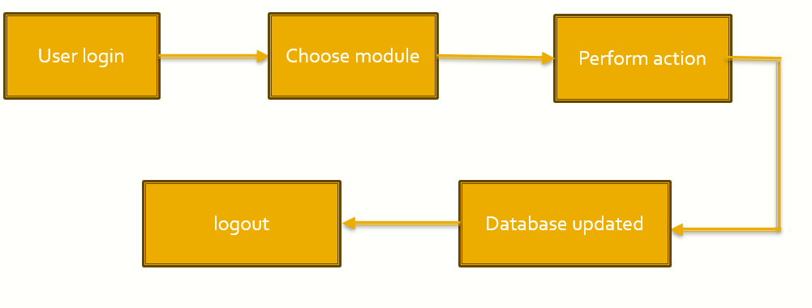
Architecture Diagram

Slide 9
Architecture Diagram Explanation
USER LOGIN -
CHOOSE MODULE
Book Management Module -Track book availability
Issue And Return Module -Issue book to the users. Return processing and uptate status.
Search Module -Search by title ,author, etc.,
Fine Management Module -Calculate and record fines for overdue books.
PERFORM ACTION – Add, Delete, Update (books ,members)

Slide 10
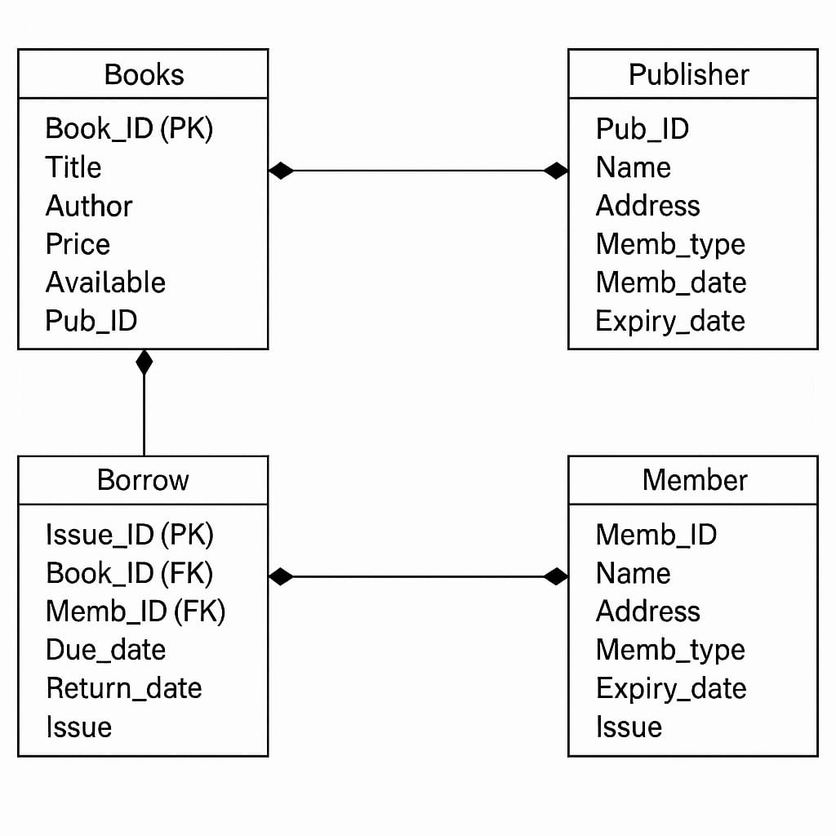
Schema Diagram

Slide 11
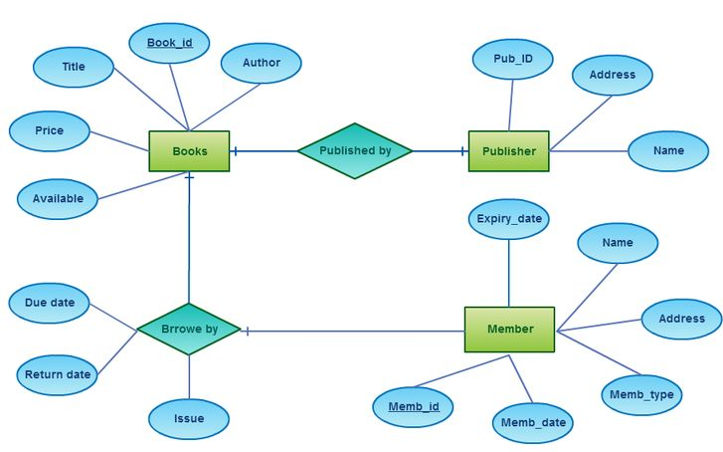
ER diagram

Slide 12
Software Description
Frontend: Tkinter (Python GUI Library)
Backend : Python 3.x
Database: MySQL (accessed via MySQL Workbench 8.0)
IDE: Any Python IDE (VS Code)

Slide 13
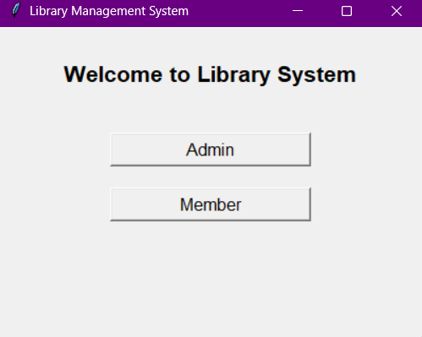
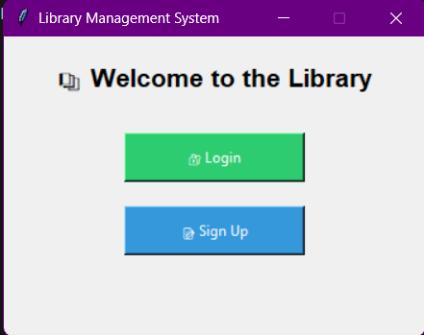
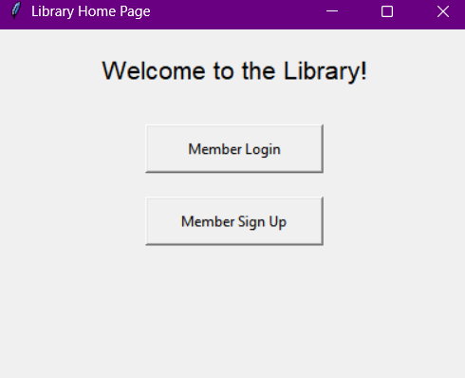
Results & Discussion
Admin Signup/Login Page
Member Signup/Login Page
The welcome page of the Library Management System provides two options: Admin and Member. Users select their role to proceed to their respective login pages. This interface ensures role-based access and streamlined user experience.

Slide 14
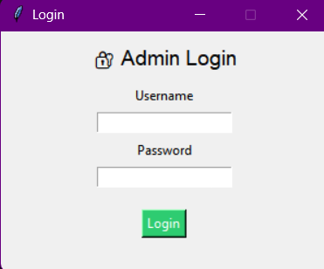
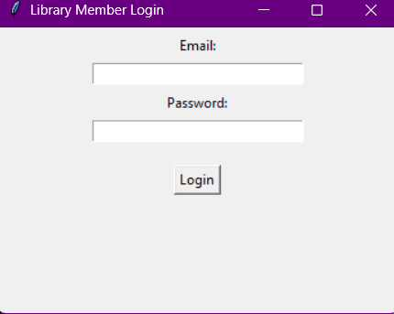
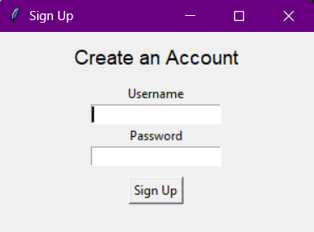
Results & Discussion
Admin Login Page
Member Login Page
Admin Signup Page

Slide 15
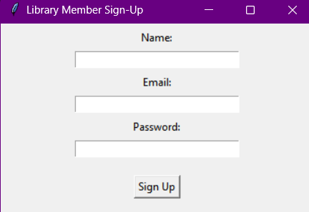
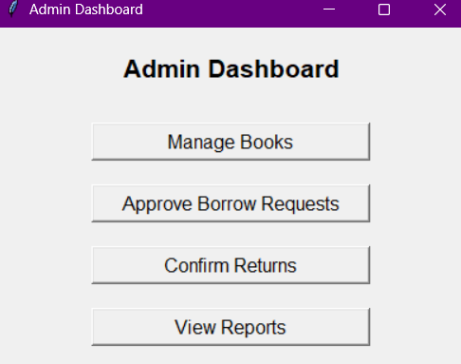
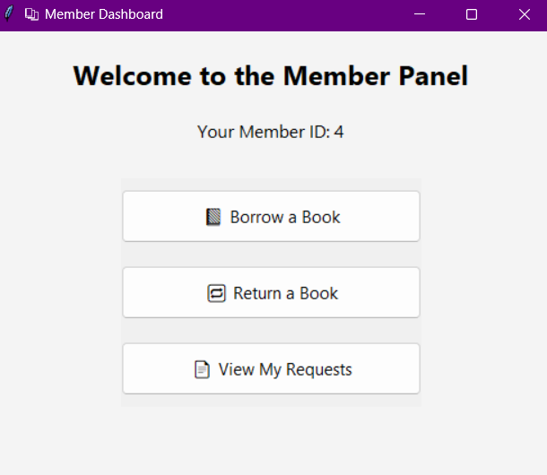
Results & Discussion
Member Signup Page
Admin Dashboard
Member Panel

Slide 16
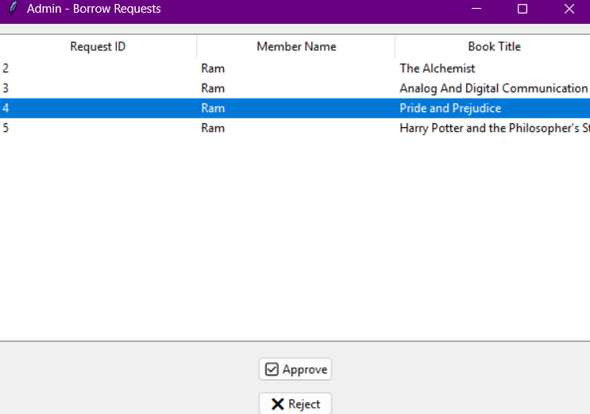
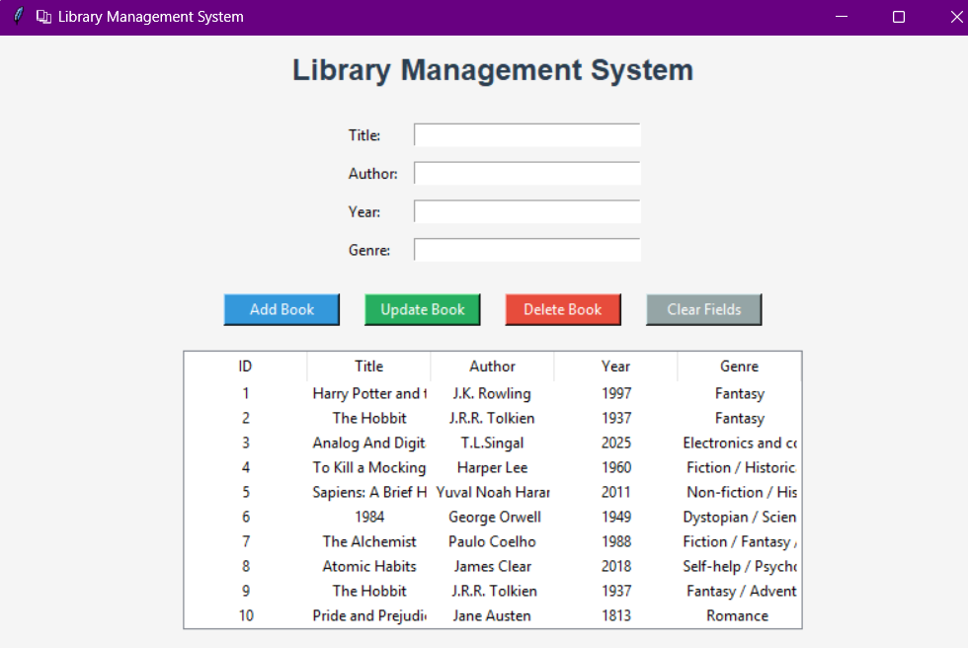
Results & Discussion
Book Management Panel
Borrow Request Approval Panel

Slide 17
Conclusion
The Library Management System effectively simplifies and automates the day-to-day operations of a library. It ensures accurate record-keeping, faster book transactions, and efficient user management. By reducing manual work and improving data handling, the system enhances the overall productivity of library staff and provides a better experience for users. This project demonstrates the practical application of database and programming skills in solving real-world problems

Slide 18
Reference
Abraham Silberschatz, Henry F. Korth, S. Sudarshan,
Database System Concepts, 7th Edition, McGraw-Hill, 2021.
Raghu Ramakrishnan and Johannes Gehrke,
Database Management Systems, 3rd Edition, McGraw-Hill, 2003.
Elmasri, Ramez and Navathe, Shamkant B.,
Fundamentals of Database Systems, 7th Edition, Pearson Education, 2016.

